Slide 1
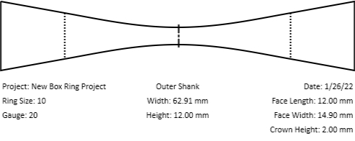
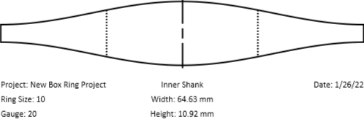
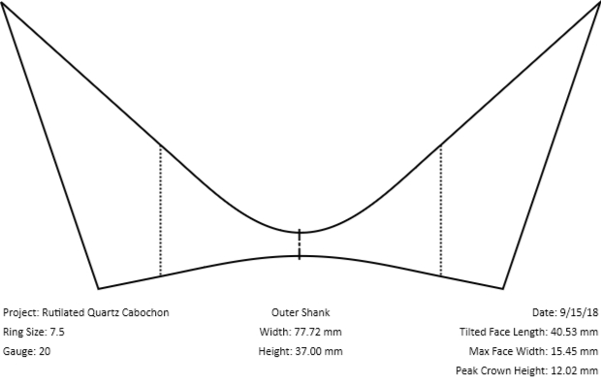
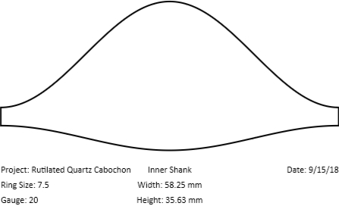
Basic Box Ring
Two Examples
I use PowerPoint to size my templates, because it’s easy to print exactly to scale.
Save the graphics templates from the tool, and insert them into a PowerPoint page. Next, set the width of each image to the width indicated in the template (don’t forget to specify units in mm). Make sure the vertical and horizontal dimensions of the graphic remain in proportion as you resize. Print your template and affix to your metal.
To keep things orderly, I record the URL of the ring in a text box along with the templates as shown to the left. You can copy the URLs into your browser to see a live rendering of these templates.
The Instagram links will show you the final shape of these styles.
See the PDF documentation under the help tab for more info.
Good luck,
Alec
62.91mm
64.63mm
https://tools.easilydistractedbyshinyobjects.com/?project_name=Basic%20Ring%20Template&ring_size=10&gauge=20&face_height=12&face_offset=0&crown_height=2&theta_left=15&theta_right=15&lock_shoulders=on&shank_size=3&joint=true&face_tilt=0
https://www.instagram.com/p/Bg2j7BYFXaH
Complex Box Ring
58.25mm
77.72mm
https://tools.easilydistractedbyshinyobjects.com/?project_name=Rutilated%20Quartz%20Cabochon&ring_size=7.5&gauge=20&face_height=37&face_offset=75&crown_height=0&theta_left=17&theta_right=17&lock_shoulders=on&shank_size=3&joint=on&face_tilt=18
https://www.instagram.com/p/BoPtEqInWO-

